Slide 1


DEPARTMENT OF MECHANICAL ENGINEERING
GRAIN COLLECTING MACHINE MINOR PROJECT FIRST REVIEW
PRESENTED BY:
M.SUDHARSAN (927622BME091)
G.SUDHAKAR (927622BME092)
C.SUGAN (927622BME093)
GUIDED BY:
Dr.K.Raju

Slide 2
INTRODUCTION
This project aims to design and fabrication of collecting and storing of grains by manually.
Main objective behind designing and fabricating the bagging and collecting of grains is to reduce the human effort and also reduce time taken for storing.
This project mainly helpful to the former the problems faced by small scale farmers relating with availability of labors and cost of collecting and storing finally It is also capable of reducing time wastage

Slide 3
WORKING
The Grains are automatically loaded into a dustpan by pushing the manual grain bagging machine with hands, a hand wheel of a drive assembly is rotated so that a gear can push a rack to move upwards at first and then move horizontally, and a stop bar on the dustpan is blocked by a left arc baffle and a right arc baffle so that the dustpan can tilt to pour the grains into an opening bag

Slide 4
Construction
A simple manually operated grain collector and bagging had the following major components:
frame, wheel, long pipe, vertical stand frame (bars), horizontal bars, collector, and bag.
Radial flat bladed type base plate, slot bar, sweeping box, bagging area, frame.

Slide 5
COMPONENTS
FRAMES
WHEELS
ROD
BEARING
MILD STEEL PLATE

Slide 6
Advantages of the proposed manual Grain collector:
➢ Manually operated, no fuel and electricity
➢ Easy of operation
➢ Single user is sufficient
➢ Single time investment and life time validity

Slide 7
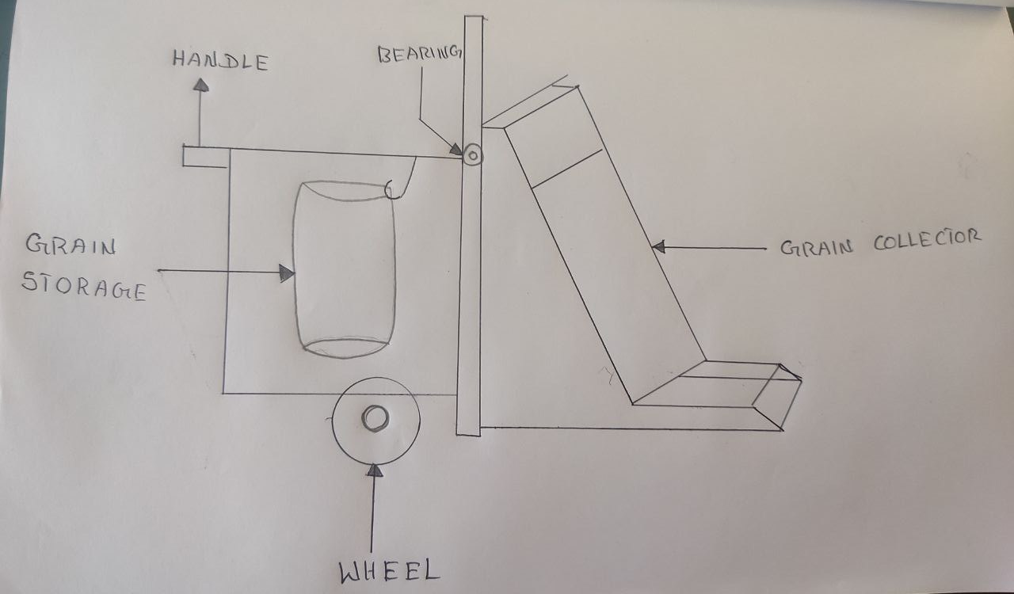
MODEL DIAGRAM

Slide 8

THANK YOU

